Slide 1
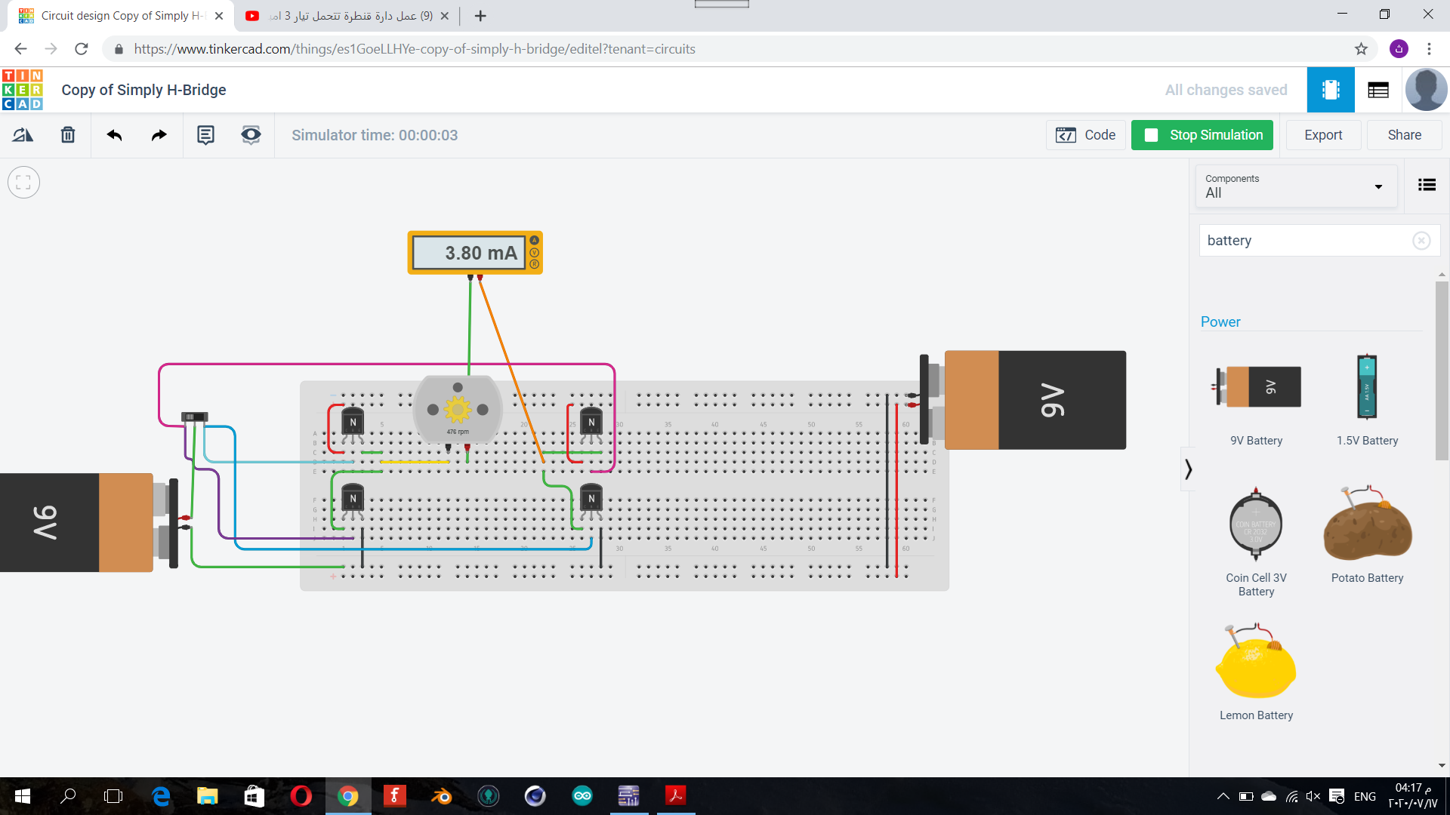
Task 1 transistor type npn bjt

